Slide 1

A Guide to Spontaneous
for Associations
2020-2021

Slide 2
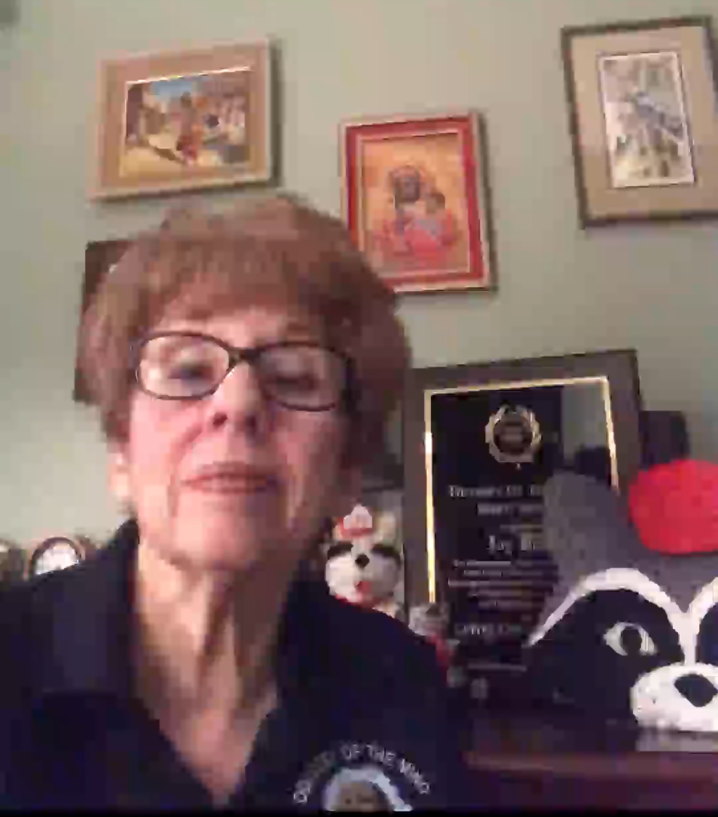

Slide 3
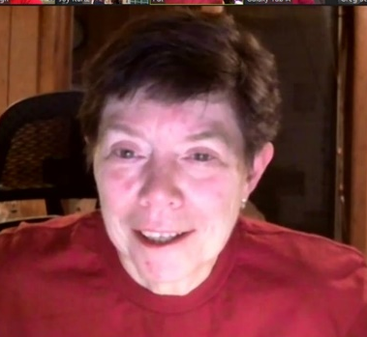
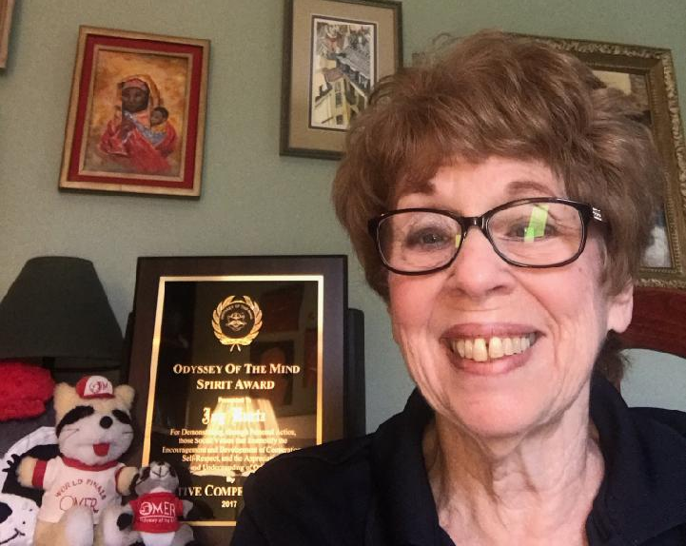
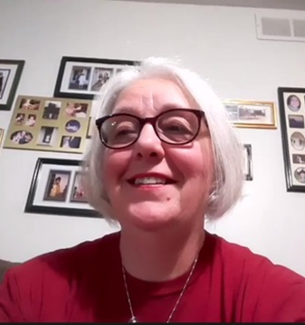
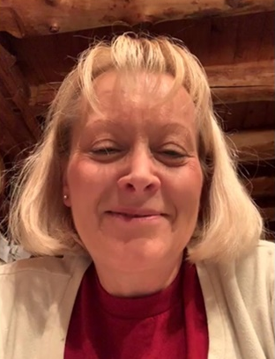
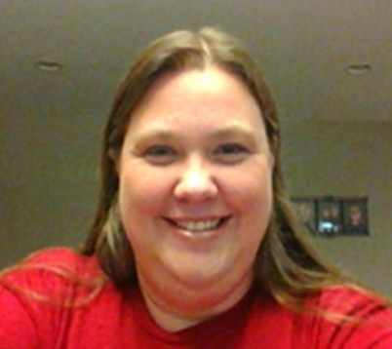

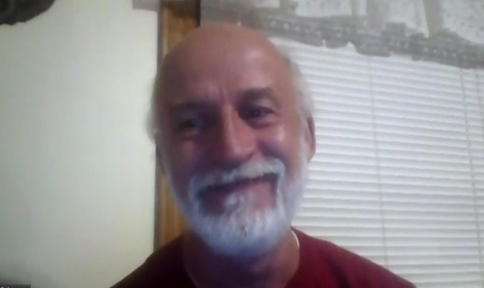
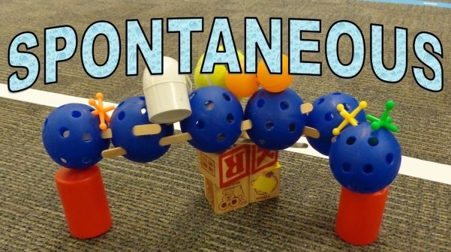

Prepared by Joy Kurtz, IPC
& her APC team of minions
Denise
JOY
IPC
Pat
Donna
The Spontaneous Bunch
Kayce
Greg

Slide 4


Comparing
Traditional/In-Person
and
Virtual/
Online
Spontaneous Competitions

Slide 5


Similarities
More than you think!!!
We are here to help you every step along the way

Slide 6




The BIGGEST
Change
All 7 team members are allowed and encouraged to participate,
regardless of the platform, and
regardless of the type of problem.

Slide 7

Some smaller but important changes

Slide 8

SPEAK UP
Regardless of the type of tournament, if the team members are together they may be required to wear a mask.
Practice speaking up so that the judges or the COACH who is typing responses can hear you.

Slide 9
All Verbal & Verbal/Hands-on Problems will still have a limited number of responses, however:
Responses will be given by all team members
Team members will NOT need to respond in any particular order unless specified in the problem
Score will not be calculated by the number of team members but by the number of total responses
No “Pass Cards” will be used
NOTE: For in-person tournaments, cards will still be used to keep track of the number of responses given.

Slide 10




In-Person Spontaneous
A Brief Overview
Be sure to follow all state and local health department guidelines

Slide 11

In-Person
NEW: All 7 team members are
allowed to compete
The rest is the same…

Slide 12
In-Person
Types of Problems: Verbal, Verbal/Hands-on, Hands-on
Verbal Responses: Limited so creativity rather than quantity of responses is rewarded
Time: Problem ends when time ends or all response cards have been used
Teamwork: In some problems points may be awarded for how well the team works together

Slide 13


Online Spontaneous
A Brief Overview
Types of Problems:
Will have only verbal problems
Responses will be entered into the computer by the Team’s COACH

Slide 14
On-Line Spontaneous
What does the COACH do?
The Coach gets the team “together”, opens the link when the team is ready to solve the problem, and types responses into the form.
The COACH may not give responses or help the team in any other way.

Slide 15
Online Spontaneous
Entering Responses
The Process:
Team members will tell their responses to the coach.
The coach will enter the responses into the response form on the computer.
Team members will confirm their responses as they will all be able to view what is being entered.

Slide 16


Online Spontaneous
Time Limit
A timer is built into the program. When the problem link is opened by the COACH, the timer will begin automatically.
Response time has been adjusted to allow for the time it takes to type the responses into the form.

Slide 17
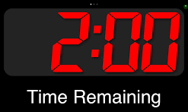

Online Spontaneous
Time Limit
We recommend teams set a timer for 2 minutes less than the time allowed for the problem. This will help them know when they are getting near the end of time.
All responses that have been entered into the form when time ends will count for score.

Slide 18





Online Spontaneous
Practice
Practice problems will be available on the
Odyssey website
Teams may use a variety of methods to compete
Teams should practice giving responses to the coach so the coach can get comfortable listening and typing responses into the form

Slide 19
Who’s Role Is It?
AD/RD/TD/PC
Specific roles may vary by Association
Recruit Judges, Coaches & Teams:
Odyssey is still the same program they know and love!
Provide Trainings: For problem captains, coaches, judges
Oversee Competition: Support all aspects of the spontaneous tournament
Resources: Provide resources and information

Slide 20
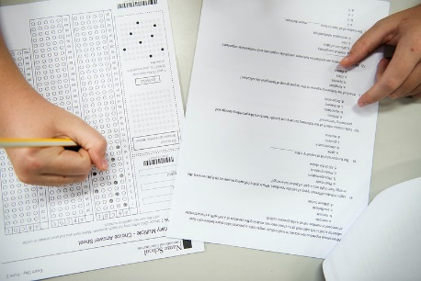
Problem Captain or Judges’ Trainer Prepares
Spontaneous Judges for
In-Person Competition
Training Day: Judges attend training and complete the certification test
Competition Day:
Be safe! Follow all local health regulations.
Read the problem, including page 2 which includes problem specifics and/or examples of common and creative responses.
Score consistently!

Slide 21

Problem Captain or Judges’ Trainer
Prepares Spontaneous Judges
For Online Competition
Pre-Tournament & Training:
Attend judges’ training via Zoom
Sample problems will be posted online to practice judging. These will include some examples of common and creative responses.

Slide 22


Online Judges
Score Teams: Schedule is flexible
A computer or tablet will be needed. Cell phones will NOT work to judge.
Judges will determine whether a response is common or creative and mark the appropriate box.
It’s Fast…It’s Fun…It’s Easy!!!

Slide 23


Online Judges
Remember: Online judges will only be judging VERBAL problems so there is no need to confer with other judges regarding scoring.
Therefore, spontaneous judges will NOT be using Discord.

Slide 24
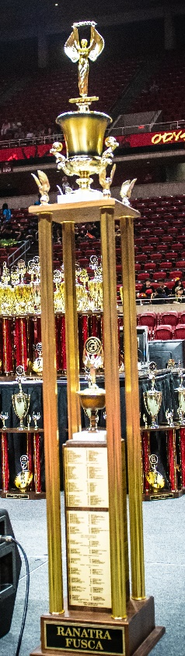
The Ranatra Fusca
A Ranatra nomination will require that the judges communicate with one another.
An electronic form will be available for nominations.
In an Online tournament, a Virtual Meeting (i.e.Zoom) is a good way to have this discussion before one judge fills out the form.

Slide 25

OMER’s Award
This award may be given for extreme generosity or excellent talent
Nominations are turned in to the Tournament Director
Anyone is allowed to make a nomination
The form is available electronically and is given to anyone who requests it

Slide 26

For Online Competitions
What do the COACHES Do?
Attend Coaches’ Training
Facilitate practices
Ensure reliable internet and technology for the competition day
Record responses for team

Slide 27

FOR ALL COMPETITIONS
Team Members
Practice, practice, practice
Solve the problem

Slide 28
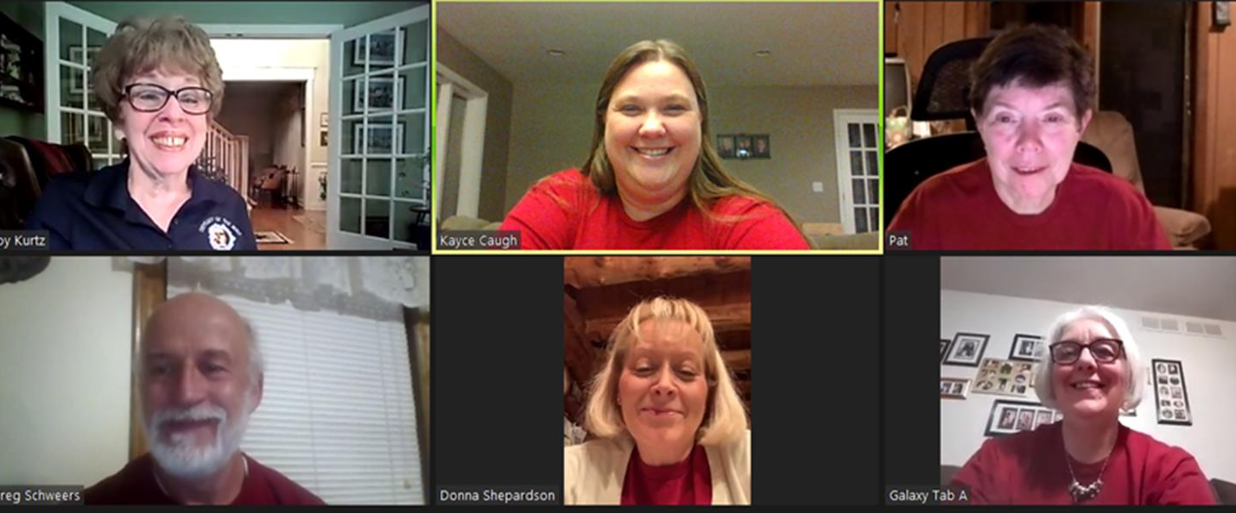
Still have questions?
Joy Kurtz, IPC
jkurtz2929@comcast.net

Slide 29
Many Thanks
I am so lucky to have such a dedicated team that comes together whenever asked to help. However, I need to give a bit of “special” recognition to these folks who always work in the background to make me look good!
Kayce Caugh APC – power point development
Pat Everett APC and Denise Schweers APC – opening song parody
Donna Shepardson APC – critical review
Greg Schweers – VPC (virtual PC) Tech support (the bass!)
Sydney Black – my wonderful granddaughter for putting together the musical segments!

